Slide 1
Working with Files & Directories

Slide 2
Credits
Some of the contents of this slide presentation have been referenced and reproduced from the textbook for this course, PHP Programming with MySQL (Second Edition) , Don Gosseling, Diana Kokoska, and Robert Easterbrooks, ©2011, Cengage Learning, All Rights Reserved. ISBN 978-0-5387-4584-0.
Thank you for some references to Kevin Skoglund, from PHP with MySQL Essential Training (2013), ©2017 LinkedIn Corporation.

Slide 3
LEARNING OBJECTIVES
Understand file types and permissions
Work with directories
Upload and download files
Write data to files
Read data from files
Open and close a file stream
Manage files and directories

Slide 4
File Types and Permissions
Introduction to Files and Directories
Many programming tasks for Web pages require some form of data storage
User files must be uploaded and downloaded
Form data must be saved and retrieved
Online resources need to be updated
These tasks are usually performed with server-stored files
File types affect how information is stored in files and retrieved from them
File permissions determine the actions that a specific user can and cannot perform on a file

Slide 5
File Types and Permissions
Understanding File Types
Binary file
A series of characters or bytes for which PHP attaches no special meaning
Structure is determined by the application that reads or writes to the file
Text file
Has mostly printable characters
Also contains a small set of control or formatting characters
Example: translate the end-of-line character sequences such as \n or \r\n to carriage returns

Slide 6
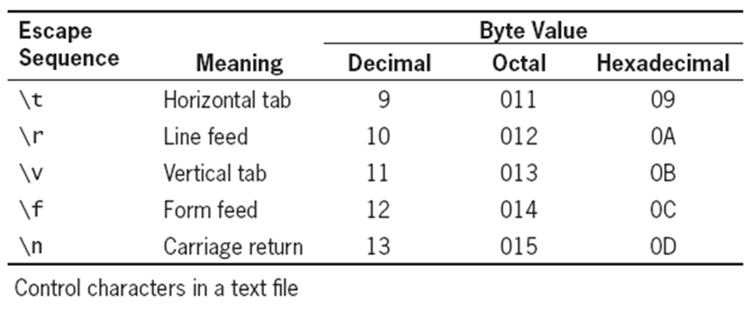
File Types and Permissions
Control Characters

Slide 7
File Types and Permissions
Control Characters
Different operating systems use different escape sequences to identify the end of a line
Use the \n sequence to end a line on a UNIX/Linux operating system
Use the \n\r sequence to end a line on a Windows operating system
Use the \r sequence to end a line on a Macintosh operating system

Slide 8
File Types and Permissions
Control Characters
You must account for differences to avoid problems
Scripts written in a UNIX/Linux text editor display differently when opened in a Windows-based text editor
PHP has functions that can usually accommodate the differences regardless of platform

Slide 9
File Types and Permissions
Working with File Permissions
The ability to access files depends on the security permissions granted to the files and directories
Files and directories usually have three access levels
User
Group
Other
The three typical permissions for files and directories
Read (r)
Write (w)
Execute (x)

Slide 10
File Types and Permissions
Working with File Permissions
PHP file permissions are calculated using a four-digit octal (base 8) value
Octal values encode three bits per digit, which matches the three permission bits per level of access
The first digit is always 0
To assign more than one value to an access level, add the values of the permissions together

Slide 11
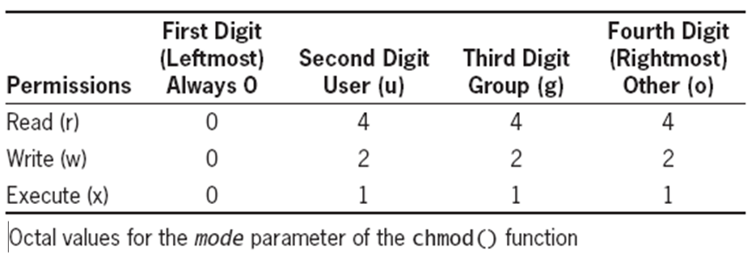
File Types and Permissions
Changing File Permissions
The chmod()function is used to change the permissions or modes of a file or directory chmod($filename, $mode)
$mode is an integer specifying the permissions for the file
To assign more than one value to an access level, add the values of the permissions together

Slide 12
File Types and Permissions
Checking File Permissions
The fileperms($fileName)function is used to read permissions associated with a file
Takes one argument and returns an integer bitmap of the permissions associated with the file
Permissions can be extracted using the arithmetic modulus operator with an octal value of 01000
The dococt() function converts a decimal value to an octal value $perms = fileperms($fileName); $perms = decoct($perms % 01000);

Slide 13
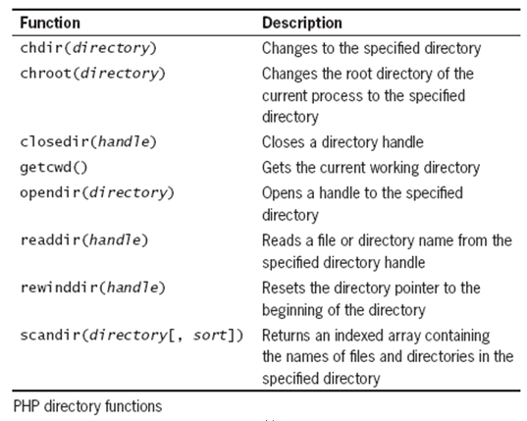
Working with Directories
Reading Directories
The following table lists the PHP functions that read the names of files and directories

Slide 14
Working with Directories
Reading Directories
The opendir()function is used to open a file handle to a directory
A special type of variable that PHP used to represent a resource such as a file or a directory
The readdir()function iterates through the file and directory names of an open directory
Each call moves a directory pointer through the directory entries
A special type of variable that refers to the currently selected record in a directory listing
Returns the current entry or false when done

Slide 15
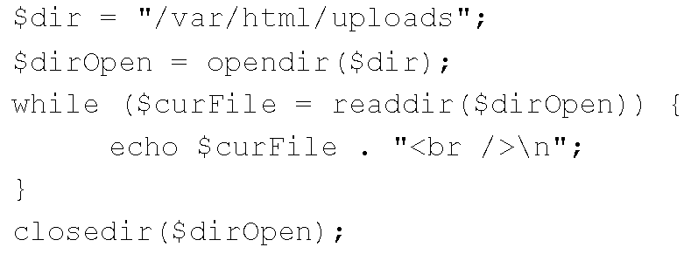
Working with Directories
Reading Directories
The closedir()function is used to close the file handle
It is very important to return resources to the OS when done
Directory reading sequence

Slide 16
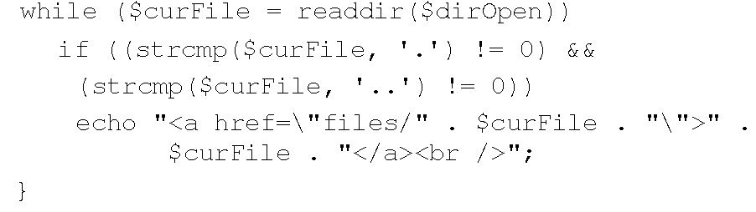
Working with Directories
Reading Directories
The PHP scripting engine returns entries for current ( . ) and parent ( .. )directory when using readdir()
The strcmp()function can be used to exclude those entries

Slide 17
Working with Directories
Creating Directories
The mkdir()function creates a new directory
To create a new directory within the current directory pass the name of the directory as an argument mkdir(”newdir”);
To create a new directory in a location other than the current directory, use a relative or an absolute path

Slide 18
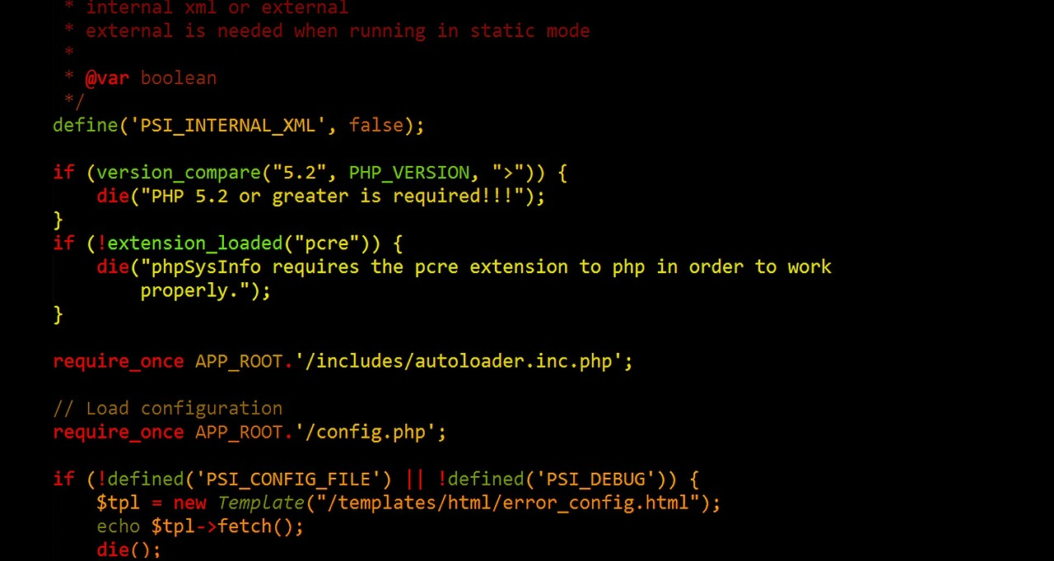
Working with Directories
Programming Exercise 02_05_01 – Step 1
Working with Directories

Slide 19
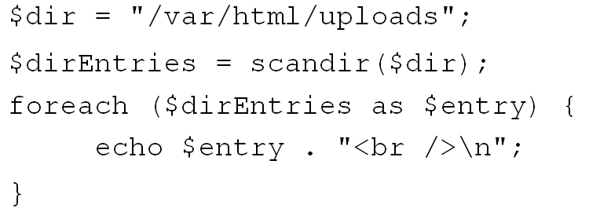
Working with Directories
Reading Directories
The scandir()function returns the names of the directory entries to an array
It is sorted in ascending alphabetical order

Slide 20
Working with Directories
Programming Exercise 02_05_01 – Step 2
Using scandir()to Read Directories

Slide 21
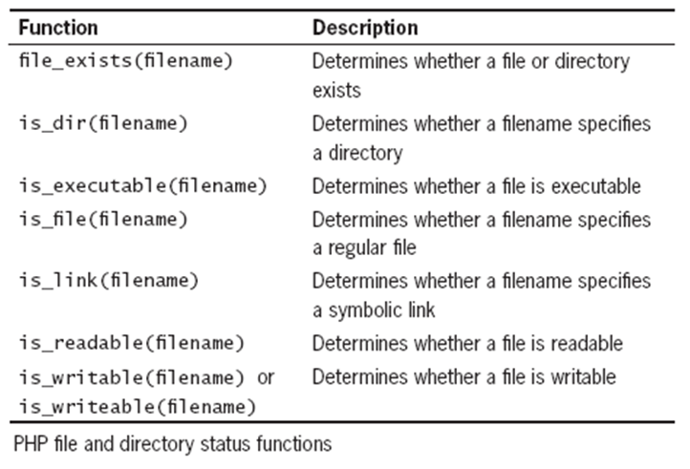
Working with Directories
Obtaining File and Directory Information
To effectively work with files and directories, a coder needs information about them
PHP provides many functions to support this

Slide 22
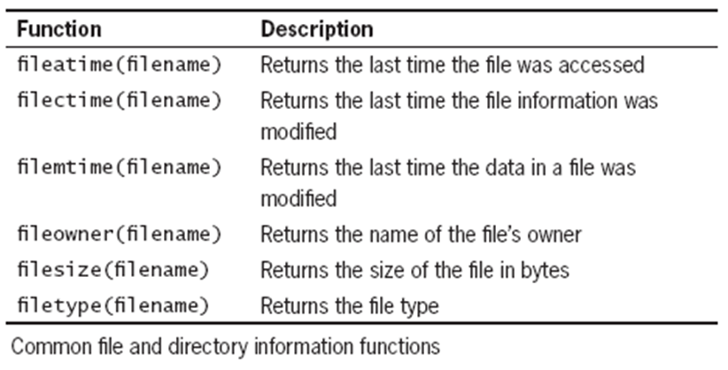
Working with Directories
Obtaining File and Directory Information
Additional PHP file and directory information functions

Slide 23
Working with Directories
Programming Exercise 02_05_01 – Step 3
Creating a More Detailed Directory Listing

Slide 24
Uploading and Downloading Files
Uploading Files
Web applications support the uploading of files to the web server from the client
The files that are uploaded and downloaded may be simple text files or more complex file types
Images
Documents
Spreadsheets

Slide 25
Uploading and Downloading Files
Selecting the File
Files are uploaded with an HTML <form> element
The post method must be used
No length limitation and more secure
An additional enctype attribute must be used in the opening <form> tag
Must have a value set to ”multipart/form-data”
Instructs the browser to post multiple sections
One section holds regular form data
The other one is for the uploaded file contents

Slide 26
Uploading and Downloading Files
Selecting the File
In the <form> element, use an HTML <input> field with the type attribute set to ”file” <input type=”file” name=”someFile”>
Provides a Browse button for file selection
Optionally, the maximum file size may be set
Before the previous field, use an HTML <input> field with the type attribute set to ”hidden”
The name attribute set to ”MAX_FILE_SIZE”
The value attribute should be set to the size in bytes

Slide 27
Uploading and Downloading Files
Programming Exercise 02_05_01 – Step 4
Creating a Form to Upload a File

Slide 28
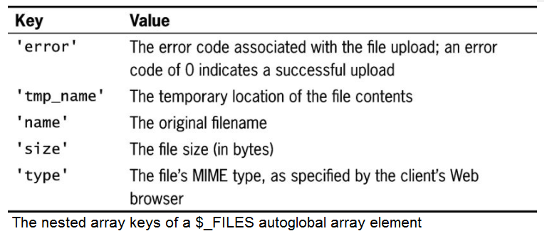
Uploading and Downloading Files
Retrieving File Information
On <form> submit, information for the uploaded file is stored in the $_FILES autoglobal array
The $_FILES[] array contains five elements for each of its file elements

Slide 29
Uploading and Downloading Files
Programming Exercise 02_05_01 – Step 5
Retrieving the File Information

Slide 30
Uploading and Downloading Files
Storing the Uploaded File
The uploaded file is first automatically stored to a temporary location
Temp location is found using the tmp_name array key
move_uploaded_file()moves it from temporary to a permanent destination with the following syntax move_uploaded_file($filename, $destination)
$filename is $_FILES['file']['tmp_name']
$destination is the path and filename of the location where the file will be stored
Returns true on success, false on failure of the move
Be sure to set the file to the proper mode with chmod()

Slide 31
Uploading and Downloading Files
Programming Exercise 02_05_01 – Step 6
Storing the Uploaded File

Slide 32
Uploading and Downloading Files
Downloading Files
To download a file from the web server to the client requires a three-step process
Tell the script which file to download
This is usually done with a URL token that the script can pick up from the $_GET superglobal array
Provide the appropriate headers
Send the file from server to client

Slide 33
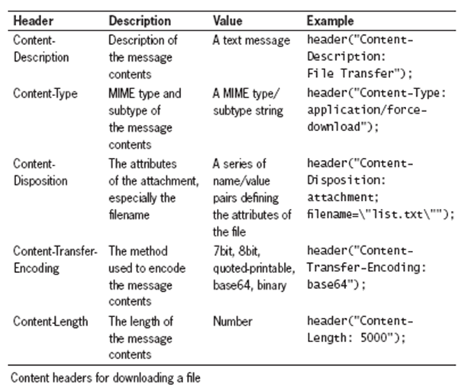
Uploading and Downloading Files
Downloading Files
The header() function is used to return header information to the Web browser
Must be executed before any HTML content
So begin file with PHP delimiters and send headers
Send file with the readfile()function

Slide 34
Uploading and Downloading Files
Programming Exercise 02_05_01 – Step 7
Downloading Files

Slide 35
Writing Data to Files
Writing an Entire File
PHP provides functions for reading and writing files
An entire file may be read into a text string
A text string may be written as a file
The file_put_contents()function writes or appends a text string to a file file_put_contents($fileName, string[, options])
Using the option FILE_APPEND constant appends data to any existing contents in the file instead of overwriting it

Slide 36
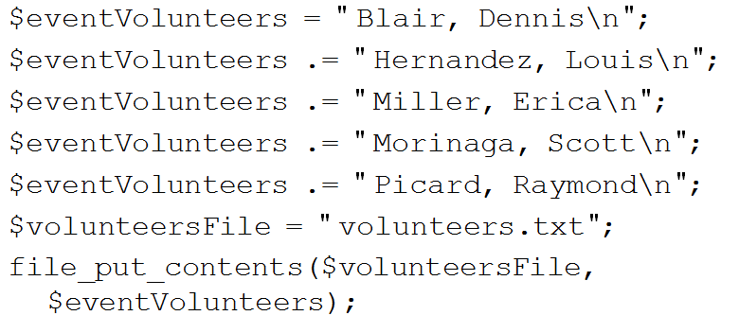
Writing Data to Files
Writing an Entire File

Slide 37
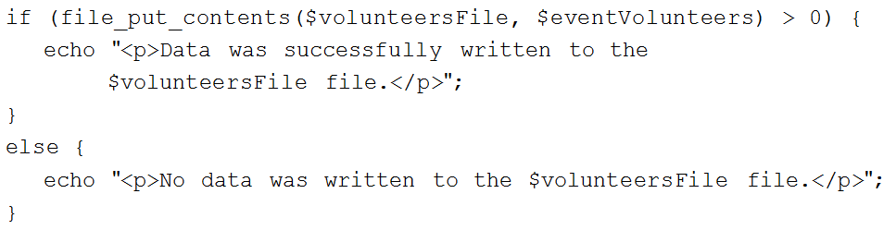
Writing Data to Files
Writing an Entire File
The file_put_contents()function
If no data was written to the file, the function returns a value of 0
Use the return value to determine whether data was successfully written to the file

Slide 38
Writing Data to Files
Programming Exercise 02_05_01 – Step 8
Writing an Entire File

Slide 39
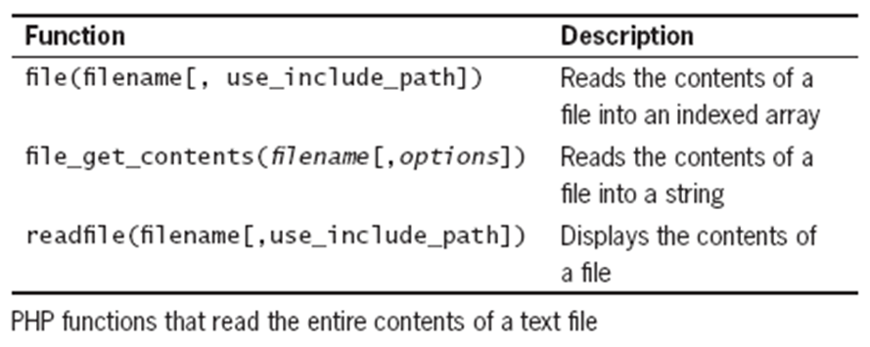
Reading Data from Files
Reading an Entire File
PHP provides a number of functions to read entire files in different ways

Slide 40

Reading Data from Files
Reading an Entire File
The file_get_contents()function reads the entire contents of a file into a string
The readfile()function displays the contents of a text file to a Web browser
The file()function reads the entire contents of a file into an indexed array
Automatically recognizes whether the lines in a text file end in \n, \r, or \r\n

Slide 41
Reading Data from Files
Programming Exercise 02_05_01 – Step 9
Reading a File with file_get_contents()

Slide 42
Reading Data from Files
Programming Exercise 02_05_01 – Step 10
Reading a File with readfile()

Slide 43
Reading Data from Files
Programming Exercise 02_05_01 – Step 11
Reading a File with file()

Slide 44
Opening and Closing File Streams
File Streams
A stream is a channel used for accessing a resource to read from or to write to
So far all of our operations have been on entire files
Streams may be used to read or write just parts of files
The input stream reads data from a resource, such as a file
The output stream writes data to a resource
Open the file stream with the fopen()function
Write data to or read data from the file stream
Close the file stream with the fclose()function

Slide 45
Opening and Closing File Streams
File Streams
A handle is a special type of variable that PHP uses to represent a resource such as a file
The fopen() function opens a handle to a file stream
Syntax
$openFile = fopen("fileName", "method");
A file pointer is a special type of variable that refers to the currently selected line or character in a file

Slide 46
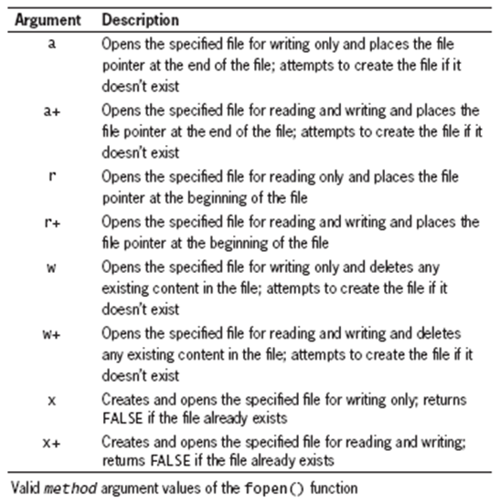
Opening and Closing File Streams
File Streams
Valid method arguments

Slide 47
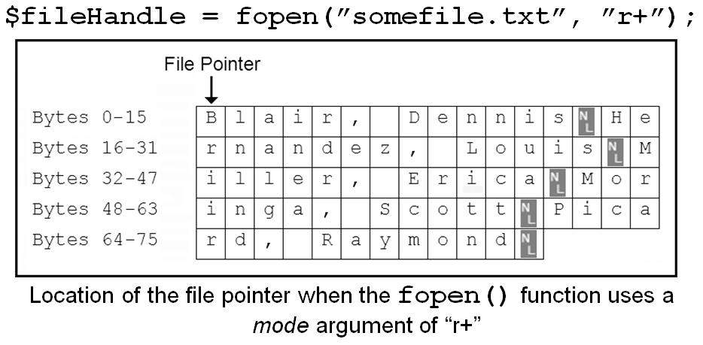
Opening and Closing File Streams
Opening a File Stream

Slide 48
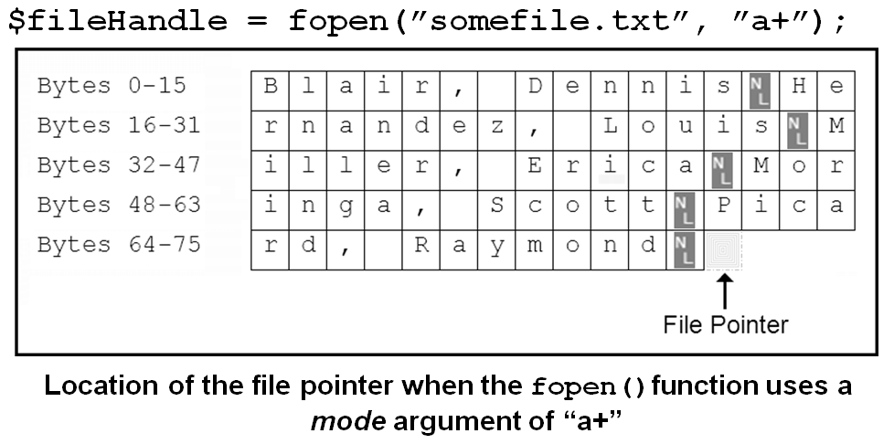
Opening and Closing File Streams
Opening a File Stream

Slide 49
Opening and Closing File Streams
Closing File Streams
Use fclose()to close a file stream
Ensures that the file doesn’t keep taking up space in computer RAM memory
Allows other processes to read to and write from the file
Returns the handle resource to the OS
Syntax
fclose($fileHandle);

Slide 50
Opening and Closing File Streams
Writing Data Incrementally
Use the fwrite()function to incrementally write data to a text file
Syntax
fwrite($handle, data[, length]);
Returns the number of bytes that were written to the file
If no data was written to the file, the function returns a value of 0
The length argument specifies writing will stop after length bytes have been written or the end of string is reached, whichever comes first

Slide 51
Opening and Closing File Streams
Programming Exercise 02_05_01 – Step 12
Writing Data Incrementally

Slide 52
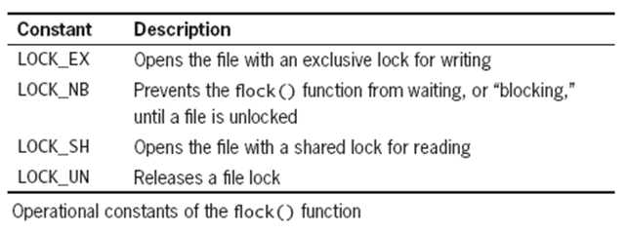
Opening and Closing File Streams
Locking Files
Use the flock()function to protect a file
The multi-user nature of servers requires some multi-user file protection
Prevent users from simultaneously modifying a file
Syntax flock($handle, operation);

Slide 53
Opening and Closing File Streams
Programming Exercise 02_05_01 – Step 13
Locking Files

Slide 54
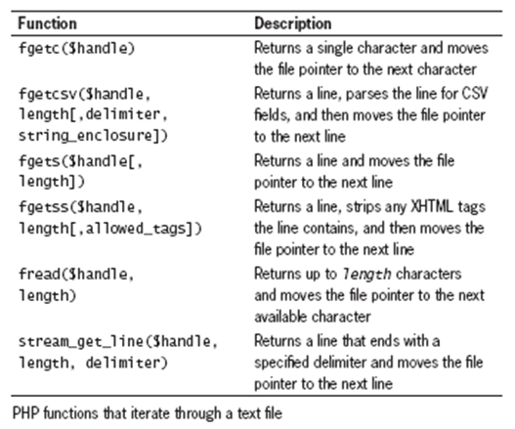
Opening and Closing File Streams
Reading Data Incrementally
The fgets()function uses the file pointer to iterate through a text file

Slide 55
Opening and Closing File Streams
Reading Data Incrementally
You must use fopen()and fclose()with the previous functions
Each time you call any of these, the file pointer automatically moves to the next line in the text file
fgetc()is the exception to this rule
With each call to the fgetc()function, the file pointer moves to the next character in the file

Slide 56
Opening and Closing File Streams
Programming Exercise 02_05_01 – Step 14
Reading Data Incrementally

Slide 57
Managing Files and Directories
File and Directory Management
PHP can be used to manage files and the directories that store them
Among the file directory and management tasks usually used are
Copying
Moving
Renaming
Deleting

Slide 58
Managing Files and Directories
Copying and Moving Files
Use the copy()function to copy a file with PHP
Returns a value of TRUE if it is successful, or FALSE if it is not
Syntax copy($source, $destination)
For the $source and $destination arguments
Include just the name of a file to make a copy in the current directory
Specify the entire path for each argument

Slide 59
Managing Files and Directories
Renaming Files and Directories
Use the rename()function to rename a file or directory with PHP
Returns a value of TRUE if it is successful, or FALSE if it is not
Syntax rename($oldName, $newName)

Slide 60
Managing Files and Directories
Removing Files and Directories
Use the unlink($fileName)function to delete files
Use the rmdir($dirName)function to delete directories
Both functions return a value of true if successful, or false if not
Use the file_exists()function to determine whether a file or directory name exists before you attempt to delete it

Slide 61
Managing Files and Directories
Programming Exercise 02_05_01 – Step 15
Copying and Moving Files

